Slide 1
Brief Update: Opioids
January 4, 2017
CWDFM
Christopher Mackie MD CCFP FRCPC
Medical Officer of Health and CEO
Middlesex-London Health Unit
@Healthmac

Slide 2
Clean Needle Program
2.5 million clean needles/syringes per year

Slide 3
Source: ODPRN, 2015

Slide 4
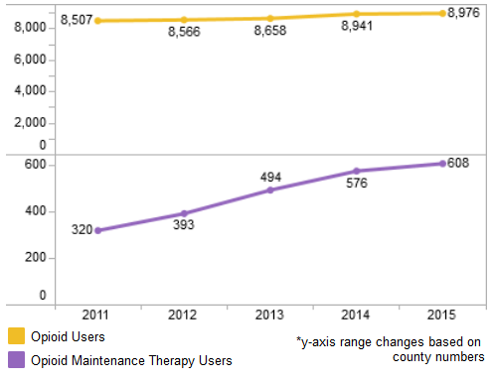
Source: ODPRN, 2015

Slide 9
Human Immunodeficiency Virus (HIV)
Source: Public Health Ontario Query (August 31, 2016)

Slide 10
Hepatitis C (HCV)
Source: Public Health Ontario Query (August 31, 2016)

Slide 11
iGAS Disease

Slide 12
Endocarditis
Source: Courtesy Dr. Koivu & Dr. Silverman, LHSC

Slide 13
HIV Classified as a Public Health Emergency in Middlesex-London
As of September 16th, Public Health Ontario data indicate there have been 45 new diagnoses of HIV in Middlesex-London in 2016, surpassing the total number of cases diagnosed in all of 2015 (42).
New cases continue to be reported at a rate of one to two per week.

Slide 14
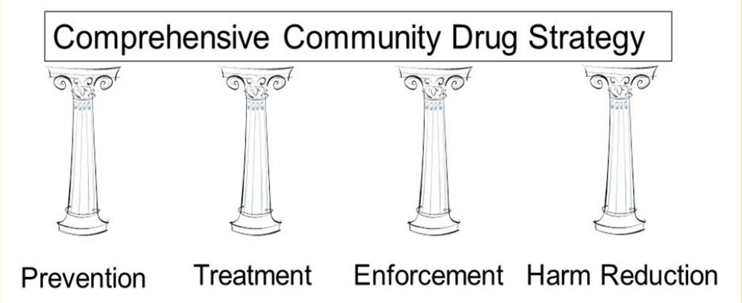
Four Pillars Approach

Slide 15
Current Action
Fentanyl Patch-for-Patch
Naloxone Program
Community Drug and Alcohol Strategy (Middlesex and London)
HIV Strategy
Provincial opioid strategy
CPSO and prescribing guidelines

